Slide 1
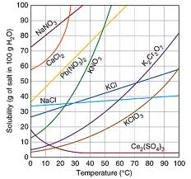
Solubility Curves
How to interpret a graphical representation of solute in solvent.

Slide 2
Saturation
• Solubility – how much solute is in a solution
• Unsaturated – the liquid (solution) can dissolve more solute (not filled)
• Saturated – the liquid is holding the maximum amount of solute possible
• Supersaturated – the liquid is holding more solute than possible
*Created by quickly heating and slowly cooling the solution*

Slide 3

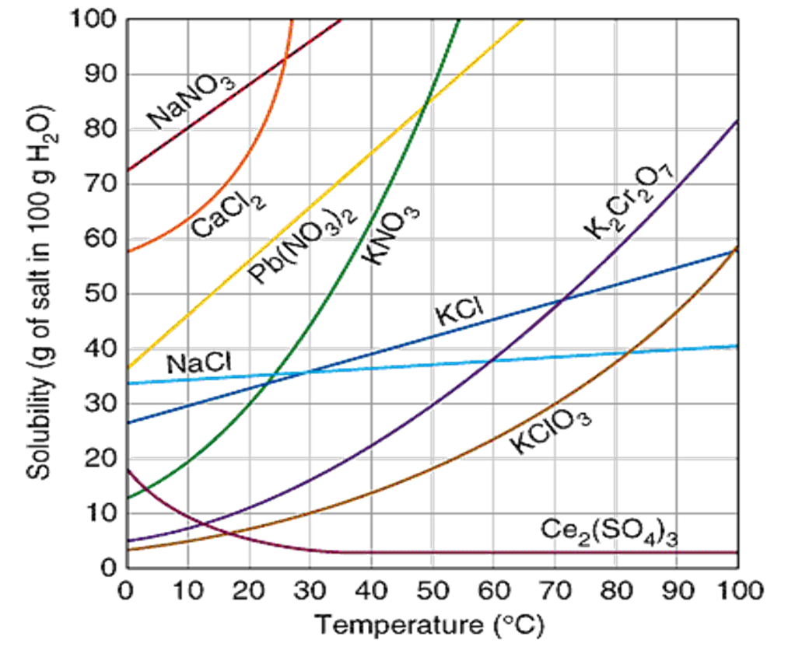


Slide 4
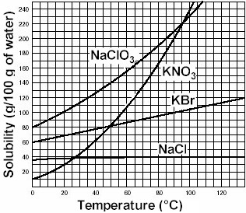
Solubility Curve
Solubility Curve – a graphical representation of the amount of substance that can dissolve into 100 g of water at a specific temperature (Celsius)
Substances: Compound being dissolved in water (H₂O)
Y-axis: Solubility of substance (g/100 g H₂O)
X-axis: Temperature (Celsius)

Slide 5
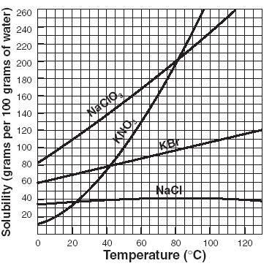
Interpreting a Solubility Curve
Each point on the solubility curve shows how many grams can be dissolved at a specific temperature:
Each line shows how much substance can dissolve as a function of the temperature of the solution.

Slide 6
Using a Solubility Curve
How many grams of potassium bromide (KBr) can dissolve in 100 grams of water at 20°C?
Answer: 70 grams of KBr can dissolve in 100g of water at 20°C
70g

Slide 7
Practice Using Solubility Curve
How many grams of potassium nitrate (KNO₃) can dissolve in 100 g of water at 60°C?
130g
Answer: 130 g of KNO₃ can dissolve in 100 g of H₂O

Slide 8
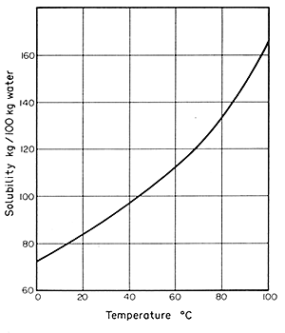
Saturated / Unsaturated / Supersaturated
Review: How we numerically describe saturation
Saturated: solute = solubility
Unsaturated: solute < solubility
Supersaturated: solute > solubility
Saturated
Unsaturated
Supersaturated
NaNO₃

Slide 9

How many grams of potassium bromide (KBr) can dissolve in 100 g of water at 20°C?
Practice #1:
70 g
Answer: 70 grams of Potassium Bromide can be dissolved in 100 grams of water at 20° C.

Slide 10
How many grams of sodium chloride (NaCl) can dissolve in 100 g of water at 100°C?
Practice #2:
40 g
Answer: 40 grams of Sodium chloride can be dissolved in 100 g of water at 100°C

Slide 11
How many grams of sodium chlorate (NaClO3) can dissolve in 200 g of water at 80°C?
Practice #3:
200 g
200g per 100 g of water, so in 200 g of water we will have to double it:
200x2=400 g NaClO3 can be dissolved in 200 g of water at 80°C

Slide 12
At what temperature can 150 grams of potassium nitrate (KNO3) dissolve in 100 g of water?
Practice #4:
65° C
Answer: 150 grams of Potassium nitrate can be dissolved in 100 g of water at 65°C

Slide 13
At what temperature can 100 grams of potassium bromide (KBr) dissolve in 100 g of water?
Practice #5:
82° C
Answer: 100 g of potassium bromide can dissolve in 100 g of water at 82°C

